Slide 1
Operations Research and Systems Analysis
Simulation, theory; discrete event simulation and agent simulation - basics
Notes:
Goal:
Basics of theory of simulation
Touch the ProModel

Slide 2
Simulation
Simulation is the imitation of a system / real world processes (over a period of time).
Computer simulation uses computer models.
Goal is to evaluate and improve system performance.
Notes:
Over a period of time – there exist static simulations.

Slide 3
Why simulation?
Why model?
Trial-and-error approach on original object is often impossible (e.g. non-ethical social experiment).
It is cheaper, faster, reproducible.
When simulation model?
It is not possible (or it is too hard) to solve the problem analytically.
It is not necessary to obtain optimal solution (nowadays, sometimes it is possible to test optimality in simulation models).
Notes:
…it is tempting, if the only tool you have is a hammer, to treat everything as if it were a nail. Abraham Harold Maslow The Psychology of Science, 1966, p. 15

Slide 4
Costs of simulation
Costs of change
Concept
Design
Implementation
Operation
Costs without simulation
Stage of system development
Cumulative costs of system development
Design
Implementation
Operation
Costs with simulation
Stage of system development
Notes:
Can be generalised for any sophisticated method, that is used correctly.

Slide 5
Simulation vs complexity
Low
Medium
High
100 %
System predictability
With simulation
Without simulation
0 %
System complexity
Call centers
Doctor‘s offices
Machining cells
Banks
Emergency rooms
Production lines
Airports
Hospitals
Factories

Slide 6
Types of simulation
Static vs. Dynamic
Stochastic vs. Deterministic
Discrete-event vs. Continuous
vs. Combination of both
Notes:
Dynamic include the passage of time
Stochastic – one or more input variables are random
Discrete-event – state changes occur at discrete points in time – e.g arrival of customer
Continuous-change – temperature of building controlled by cooling system
Combination: e.g. Truck arrives at a fill station (a discrete event) and begins filling a tank (a continuous event)
1) continuous variable value suddenly increase or decrease as the discrete event (e.g. replenishment of inventory)
2) Initiation of a discrete event occur as the result of reaching a threshold value in a continuous variable (reaching the a reorder point in an inventory model)
3) The change rate of a continuous variable may be altered as the result of a discrete event (sudden change in demand change the inventory usage rate)
4) An initiation or interruption of change in a continuous variable may occur as the result of a discrete event (the depletion of inventory terminate the sells)

Slide 7
Simulation project
Identification of problem
Specification of objective and project plan
Data collection and analysis
Model construction and validation
Simulation, experiments with model
Presentation of results, implementation
Notes:
Ad 2) project plan needs to be developed to determine the resources, time, budged requirements
Ad 3) step 3 results in conceptual model and data document on which all can agree
Ad 4) contains also debuging
Ad 5) testing different scenarios

Slide 8
Monte Carlo Simulation
Static* and stochastic simulation is usually referred as Monte Carlo simulation.
Based on repeated random sampling to compute the results and make a statistical analysis.
„Roots of simulation“:
First computer Monte Carlo models are connected to project Manhattan and J. von Neuman, N. Metropolis, S. Ulam (nuclear weapons program, 1940s).
What do you know about randomness in computer modelling?
*not always some authors say e.g. “Any method which solves a problem by generating suitable random numbers and observing that fraction of the numbers obeying some property or properties.“ http://mathworld.wolfram.com/MonteCarloMethod.html
Notes:
Randomness in computer modelling:
Example linear congruential generator LCG
X_{n+1} = (aX_{n} + c) (mod m)
a, c, m chosen parameters, m depends on computer speed, some author says 2⁶⁴ is not enought
Period is always ≤ m
X₀ is so called seed, commonly the current time
Modulo – reminder after integer division
Funkce =mod
Example show in Excel
a = 18
c = 13
m = 17
Seed = 10
ProModel provides more than 2.1 bilion different values before cycling
MCMC

Slide 9
Example
Typical example – draw a circle and a square around (side of square a is equal to double radius of circle 2*r)
Throw randomly (uniform distribution is necessary) same coins into the square.
Ratio of coins inside the circle to all coins in square is approximation of π/4.
The more coins you throw the more accurate your approximation will be.

Slide 10
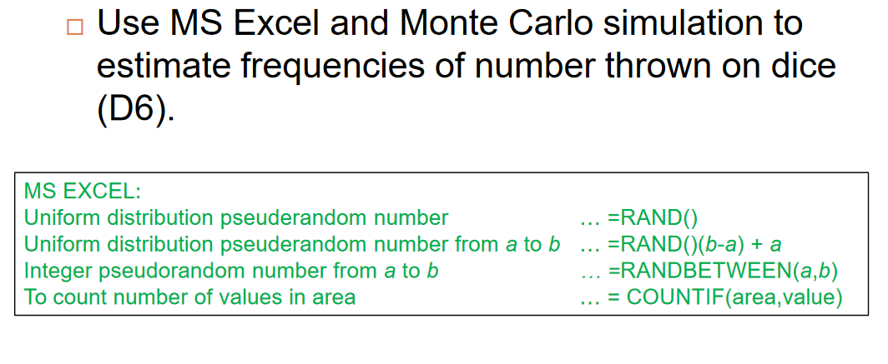
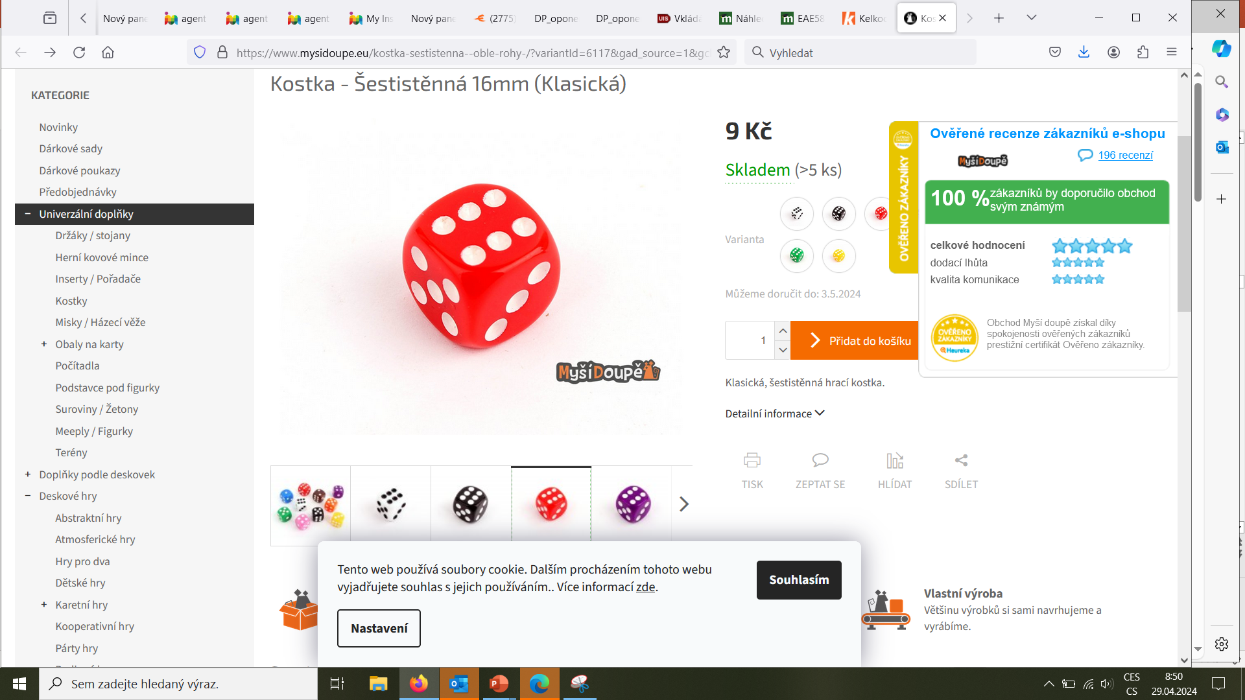
Example

Slide 11

Agent-based simulation
Agent
The single most important defining characteristic of an agent is its capability to act autonomously that is, to act on its own without external direction in response to situations it encounters.

Slide 12
Agent-based modelling and simulation (ABMS)
More general concept
particle swarm optimization
ant optimization algorithms
both inspired by agent-based modelling approaches and are used to achieve an end (optimal) state rather than to investigate a dynamic process, as in a simulation.

Slide 13
Agent-based simulation
Modelling complex systems composed of interacting, autonomous ‘agents’.
The emphasis on modelling the heterogeneity of agents across a population and the emergence of self-organization are two of the distinguishing features of agent-based simulation as compared to other simulation techniques such as discrete event simulation and system dynamics.

Slide 14
Agent-based simulation
Agents have behaviours, often described by simple rules, and interactions with other agents, which in turn influence their behaviours.
By modelling systems from the ‘ground up’– agent-by-agent and interaction-by-interaction.
Patterns, structures, and behaviours emerge that were not explicitly programmed into the models, but arise through the agent interactions.

Slide 15
Agent-based simulation: elements
Set of agents, their attributes and behaviours.
A set of agent relationships and methods of interaction: An underlying topology of connectedness defines how and with whom agents interact.
The agents’ environment: Agents interact with their environment in addition to other agents.

Slide 16

Agents
Autonomy:
act on its own without external direction in response to situations it encounters.
Active:
initiating their actions to achieve their internal.

Slide 17
Modelling autonomy
behaviour can range from simplistic and reactive ‘if-then’ rules to complex behaviours modelled by and adaptive artificial intelligence techniques

Slide 18
Agent - characteristics
Self-contained, modular, and uniquely identifiable individual.
i.e. agent has a boundary.
An agent is autonomous and self-directed.
function independently in its environment and in its interactions with other agents
An agent has behaviours that relate information sensed by the agent to its decisions and actions.

Slide 19
Agent - characteristics
Agent has a state that varies over time
agent’s state consists of a set or subset of its attributes
Agent is social
having dynamic interactions with other agents that influence its behaviour

Slide 20
Agent – other possible characteristics
Agent may be adaptive
may have the ability to learn and adapt its behaviours based on its accumulated experiences.
Learning requires some form of memory.
Populations of agents may be adaptive through the process of selection, as individuals better suited to the environment proportionately increase in numbers.
Agent may be goal-directed
compare the outcome of its behaviours relative to its goals and adjust its responses

Slide 21
Agent – other possible characteristics
May be heterogeneous
Agent characteristics and behaviours may vary
Agents may also be endowed with different amounts of resources or accumulate different levels of resources

Slide 22
Agent - interaction
Only local information is available to an agent
Agent-based systems are decentralized systems
No central authority that either pushes out globally available information to all agents or controls their behaviour in an effort to optimize system performance

Slide 23
Agent - interaction
Not all agents interact directly with all the other agents all the time
How agents are connected to each other is generally termed an agent-based model’s topology
A topology describes who transfers information to whom
Agents could interact according to multiple topologies

Slide 24
ABS – simple example
John Conway's Game of Life
Notes:
ABS Agent Based Simulation
Vysvětlit pravidla
Pak projet přednastavené možnosti vlevo dole

Slide 25
ABS - applications
agent behaviour in the stock market
supply chains
to predicting the spread of epidemics
the threat of bio-warfare
modelling the adaptive immune system
understanding consumer purchasing behaviour
from understanding the fall of ancient civilizations
to modelling the engagement of forces on the battlefield

Slide 26

Preparation for the exam
Create SFD according to following text – part I
Lemming
The population of lemmings is increased by the increase of lemmings, which depends on the average birth rate of lemmings. The larger their population, the larger the increase. Their population is then reduced by their decline, which is mainly influenced by the hunting of lemmings by their natural predator, the ermine. How much lemming hunting affects their decline is expressed by the average conversion of hunting to lemming decline.

Slide 27

Preparation for the exam
Create SFD according to following text – part II
Ermine with a lemming
The population of ermines is increased by their increase, which is also mainly dependent on the hunting of lemmings, because the more lemmings they catch, the better they do and the greater their increase, which is expressed by the average conversion of hunting to the increase of ermines. The decline of ermines, which reduces their population, is influenced mainly by the average mortality of ermines. The larger their population, the greater their decline. The hunting of lemmings is greater the greater the population of lemmings and the population of ermines.

Slide 28
Thank you for your attention.

